Slide 1
Airport website
My name is Purevbayar.Kh My group members: Amarjargal .Ts and Uuriintuya.B

Slide 2
● Why is this program useful?
This website is purpose to more easily employees operation.
Our website can do
the airports information
flights schedule
control the action
ordering ticket
baggage information

Slide 3
● Why is this program different from other programs?
Our project ‘s design and action is than more differentiate other websites.
For example:
weather widget show and show condensation last news in home page.

Slide 4
● How will this program help people?
Save time to airports customers.
Users anyone location visit to airport website then get the airports all informations.

Slide 5
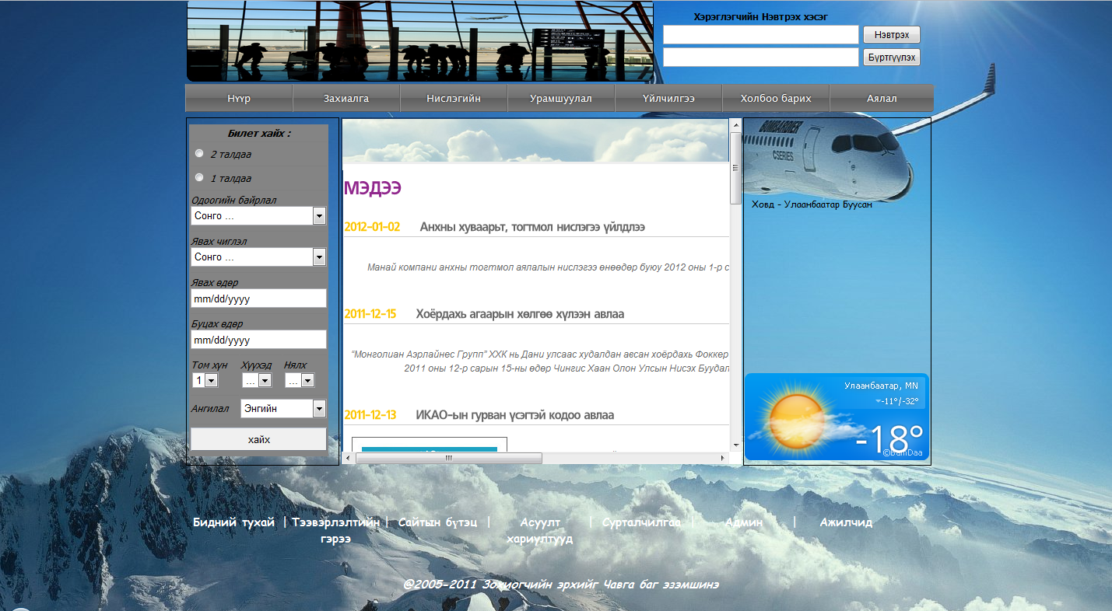
● What design decisions have you made?

Slide 6
Use case

Slide 7
Any question?

